Slide 1
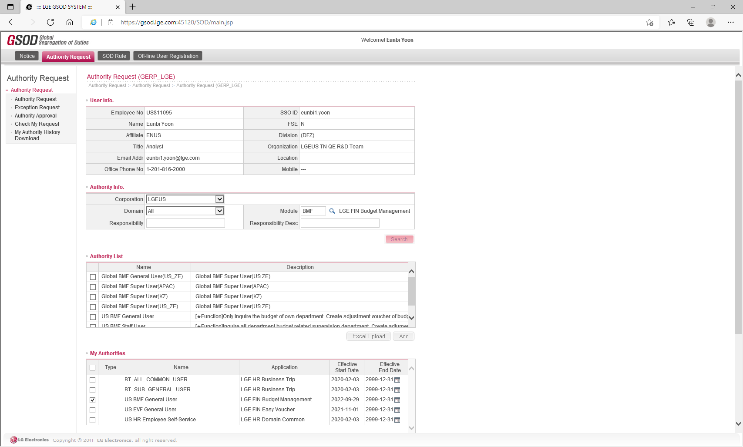
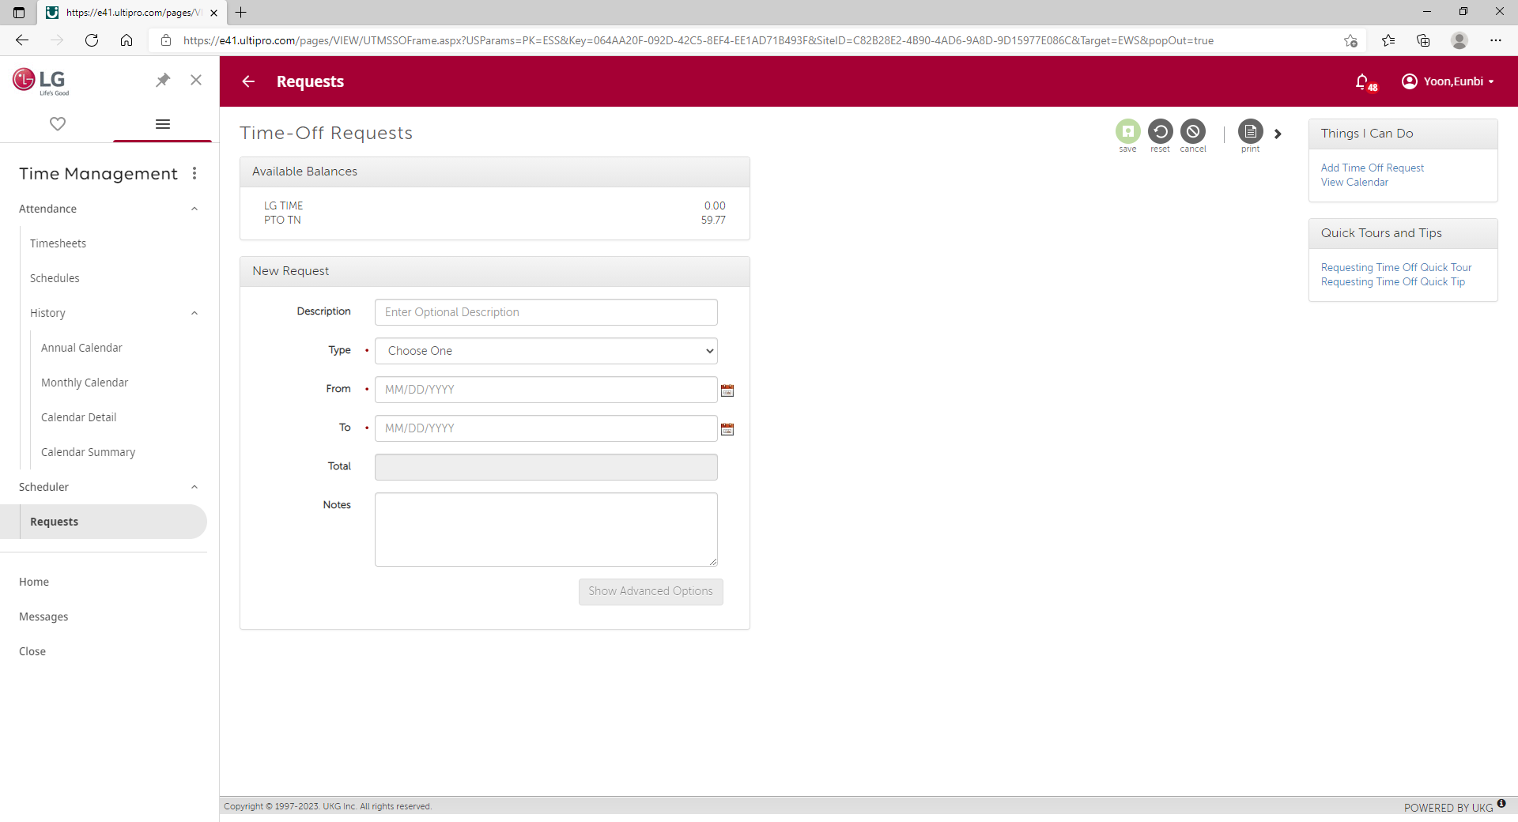
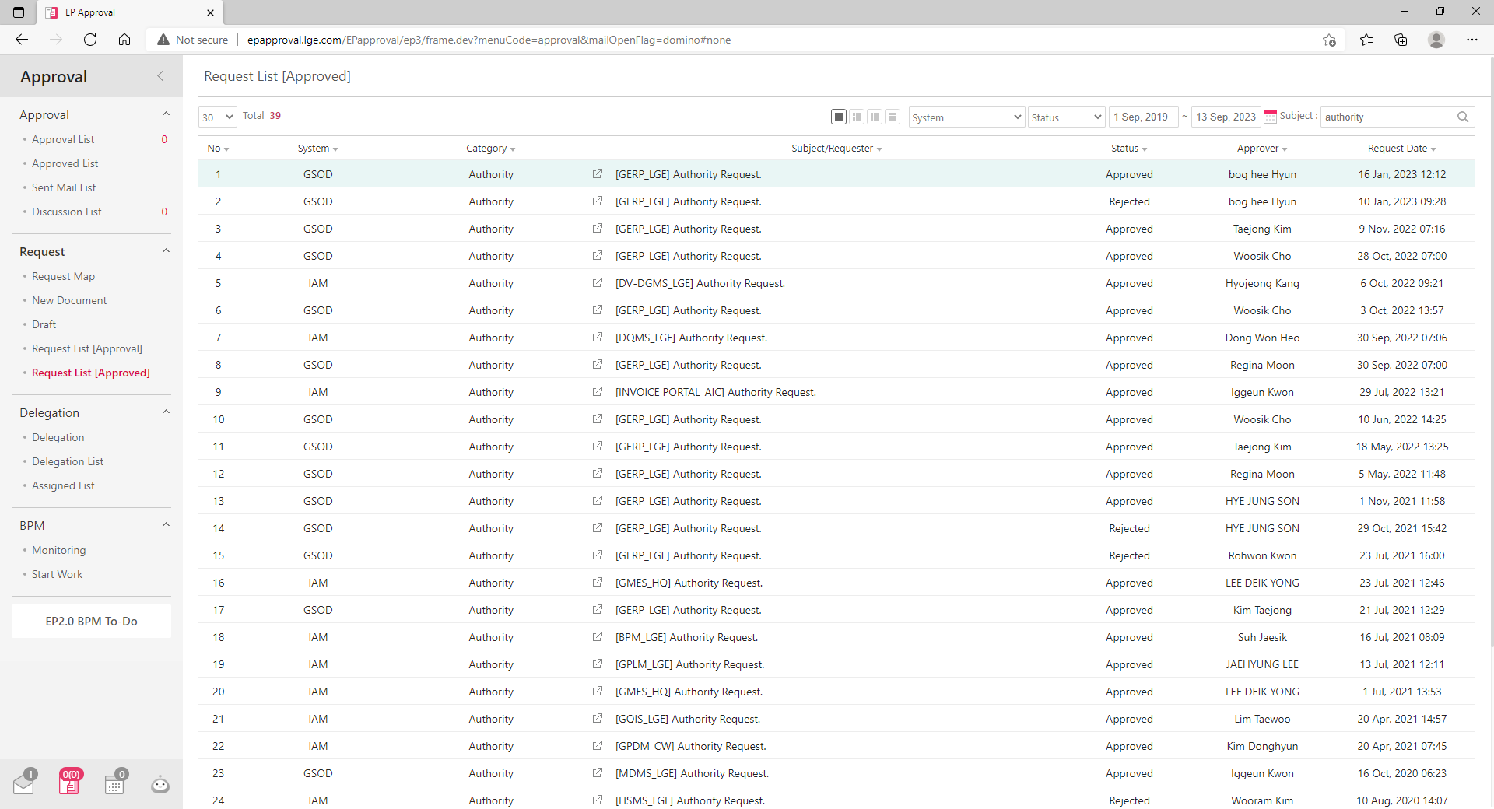
0. REINVENT Center Main
You should log in to access this website and if you are logout it when you click some buttons to move page you will connect to login page automatically
Website has two types of accounts authority, Admin and User. User Authority is approval requester and Admin Authority is approver, usually security member
Site Map
Authority
Function
Admin
HR Team PIC,
Developer
My Day
Register My Day,
Send Notification of My Day
Account
Reinvent Center
User
LGETN All Member
Flexible Workhours
Calculate next day work start time,
Send Notification of request
System Design Idea Comes From LG System
This site has been developed as a reference for the various operating methods of the LG system to provide a friendly LG’s user experience.
Account Authority
Request Function
Approval Function
LG NewEP Authority
Provides System
: IAM, GSOD
LG4ME PTO
Request System
: Time Management
LG NewEP
Approval System
: EP Approval

Slide 2
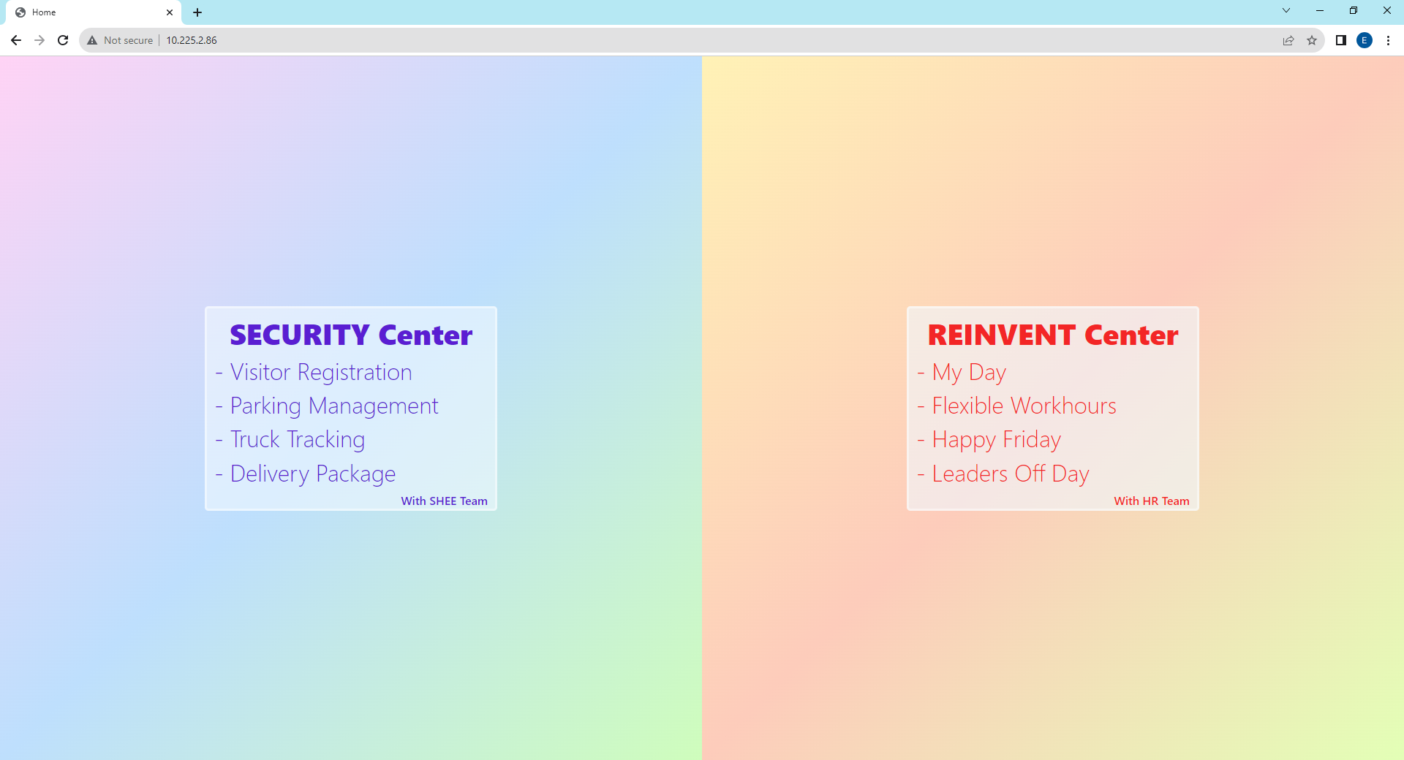
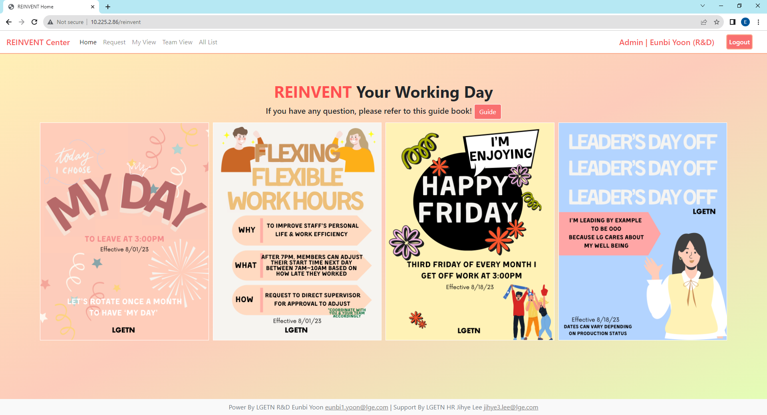
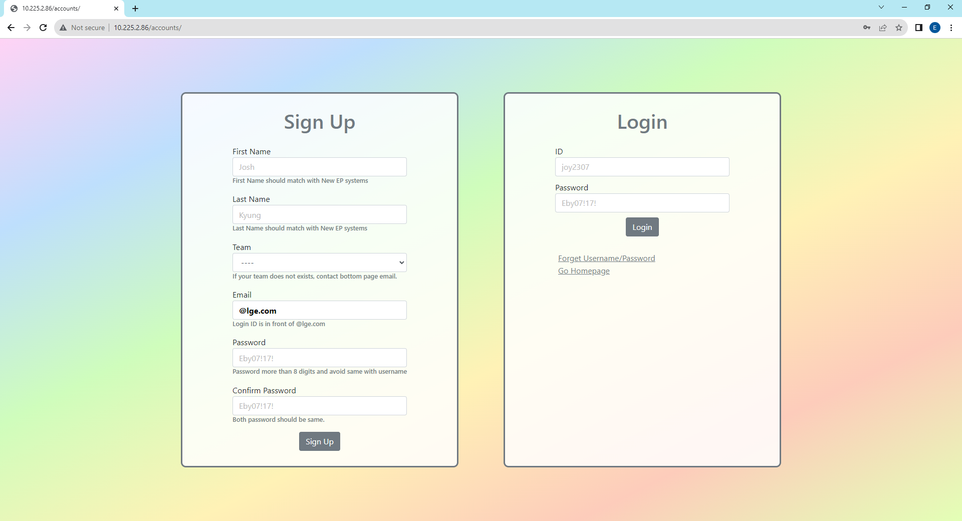
1. Sign Up & Login Page
You should log in to access this website and if you are logout it when you click some buttons to move page you will connect to login page automatically
When you sign up here, you will get user authority, if you need Admin Authority then send your all sign up information referring sign-up form (eunbi1.yoon@lge.com)
For sign up, all blanks are required and check detailed requirements below blanks and password different with username. e.g. username : user, password : user1357(X).
Email address should be @lge.com for security purpose.
Main Page
Log-In
Authority | First Name Last Name (Team Name)
If you are already login, it will link you to this page
Click this field if you want to move to reinvent center
Log-Out

Slide 3
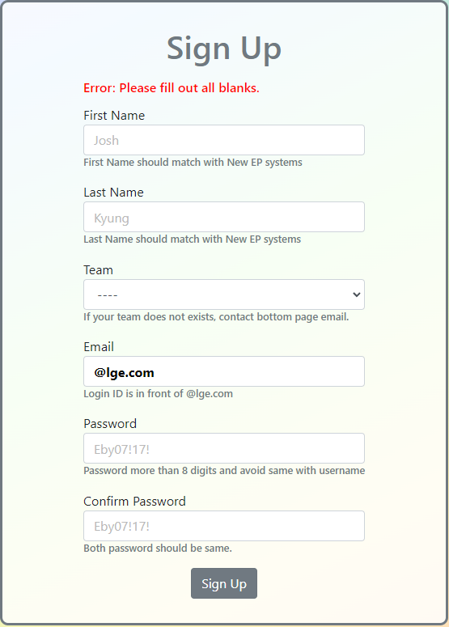
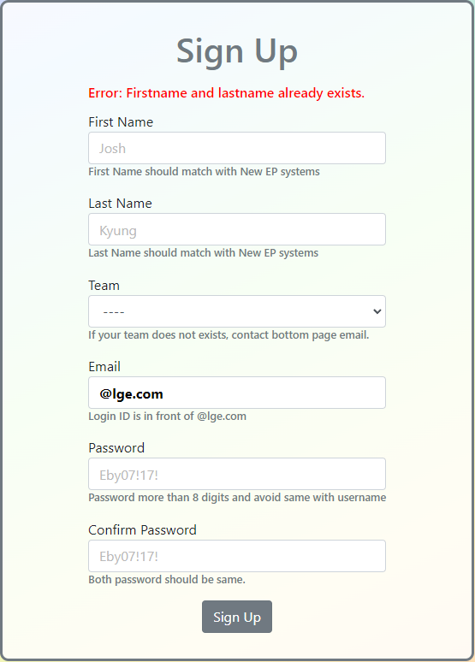
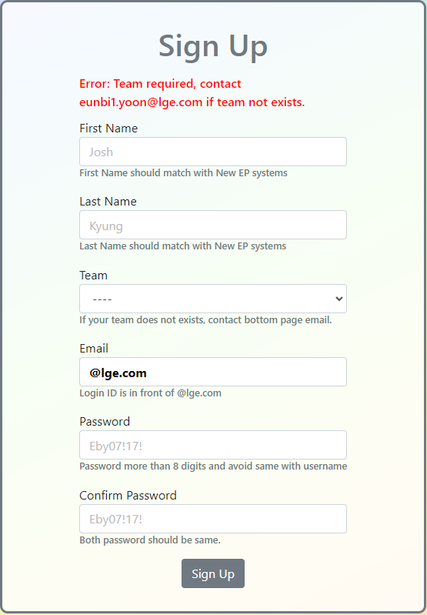



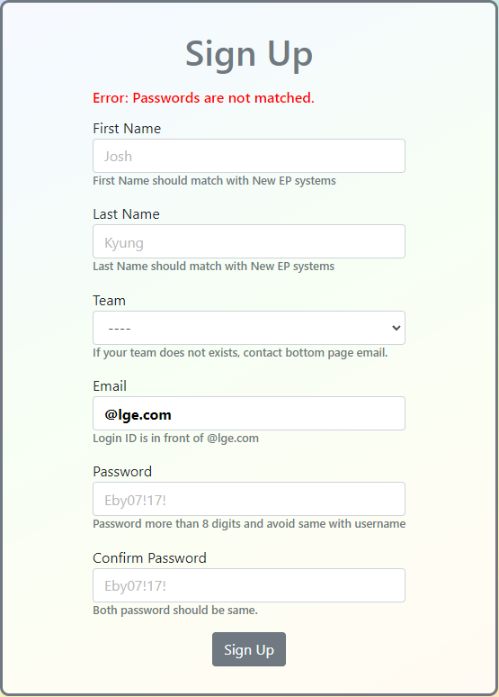
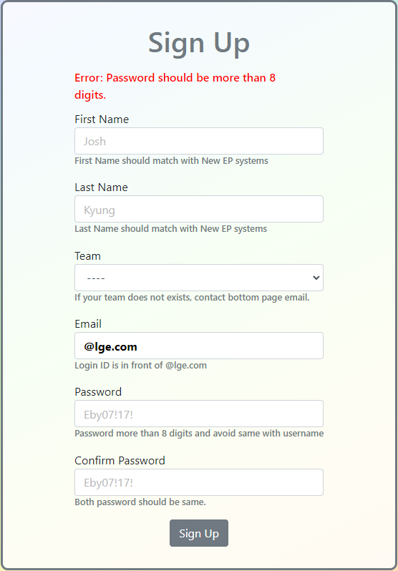
1. Sign Up Page – Error Logic
Serialized Structure : Define all occurred errors and you can make accounts when you avoid all these errors below
N
N : No Error Exist
Error 1
N
Error 2
N
Error 3
Error 4
N
Error 5
N
Error 6
N
Error 7
N
True
Error 1. Did not fill out all blanks
→ Fill out all blanks
Error 2. Accounts already exists
→ Try “Forget Username
/Password” in Login Section
Error 3. Not Select Team
→ Select your team, if there is no your team, check
Error 4. Email Already Exists
→ Try “Forget Username
/Password” in Login Section
Error 5. email address has no “@”
→ Email address Add “@”
Error 6. Email Address Not lge.com
→ Check Email address is @lge.com
Error 7. Password is not matching
→ Check Password and Confirm Password are matching
Error 8. Password shorter than 8 digits → Password Length can be same or larger than 8 digits

Slide 4
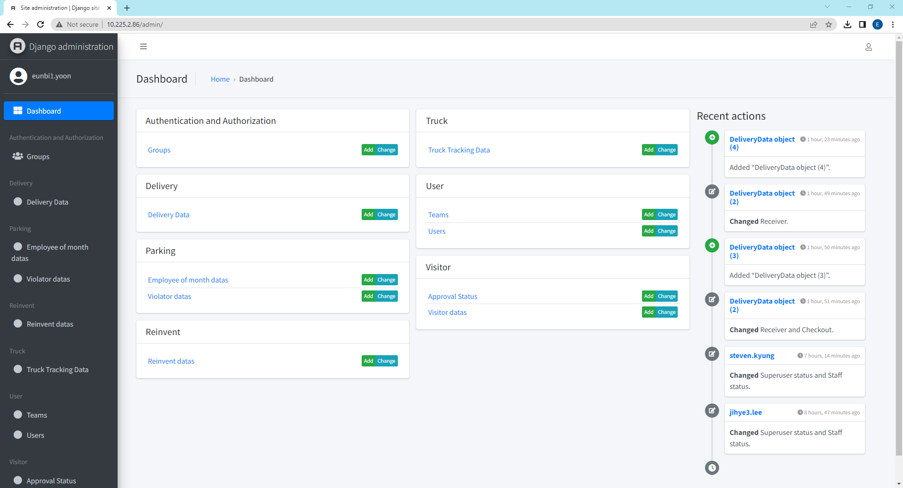
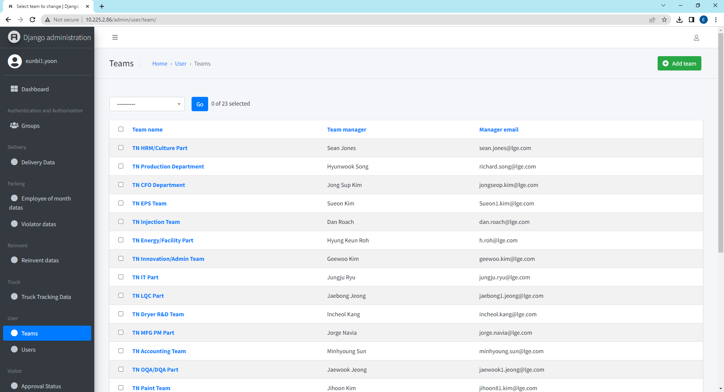
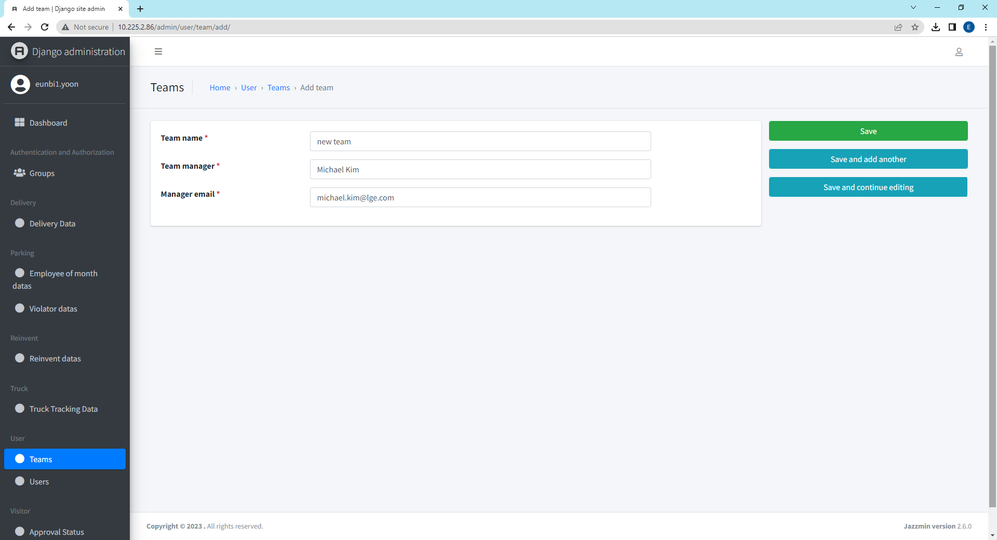
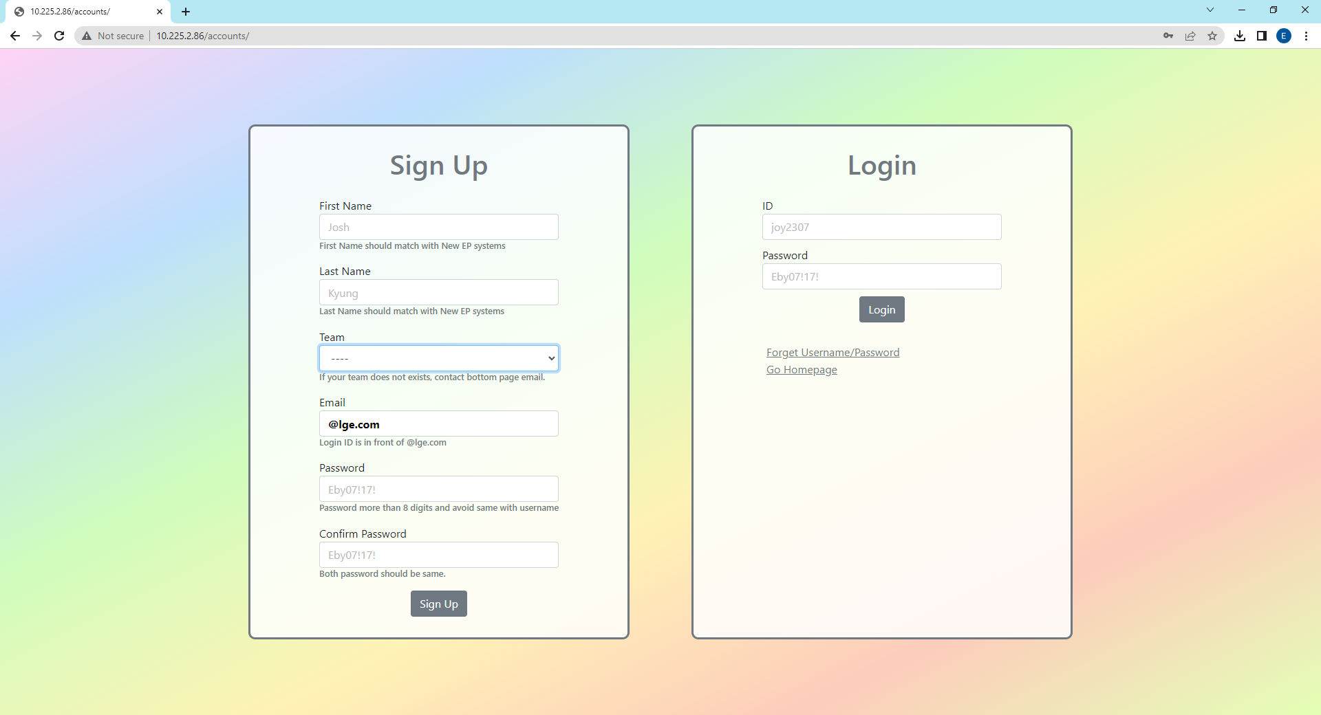
Appendix. How to add/edit team information
This guide for HR admin to register new team or change team manager. Please access to http://10.225.2.86/admin/
If are not able to login this page then you don’t have authority, please contact to get admin authority eunbi1.yoon@lge.com
1
2
Click to add team
Click Team Database
Click to edit team
3
4
Edit or Add information and hit the save
If you add new team,
now you can see in here

Slide 5

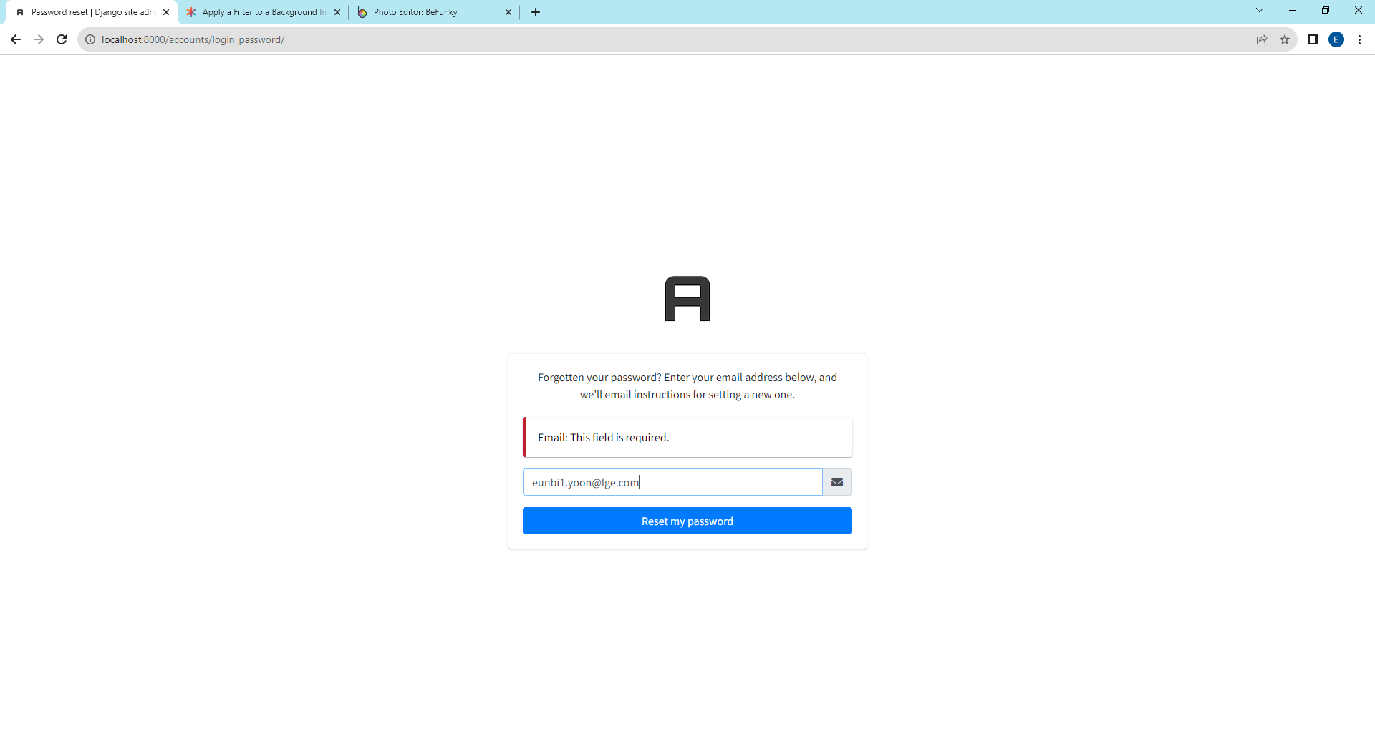
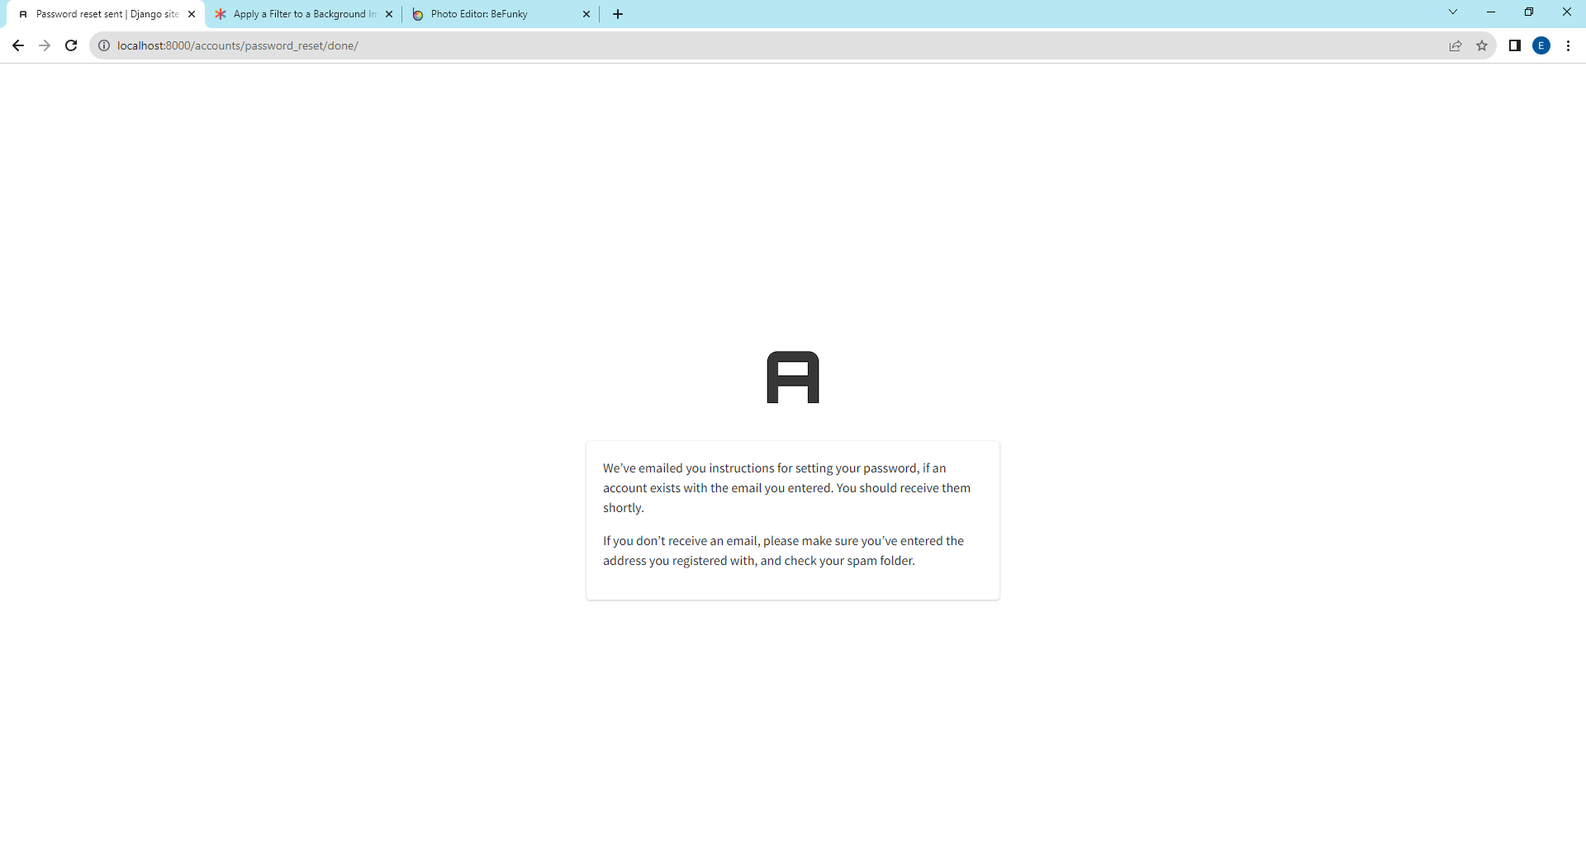
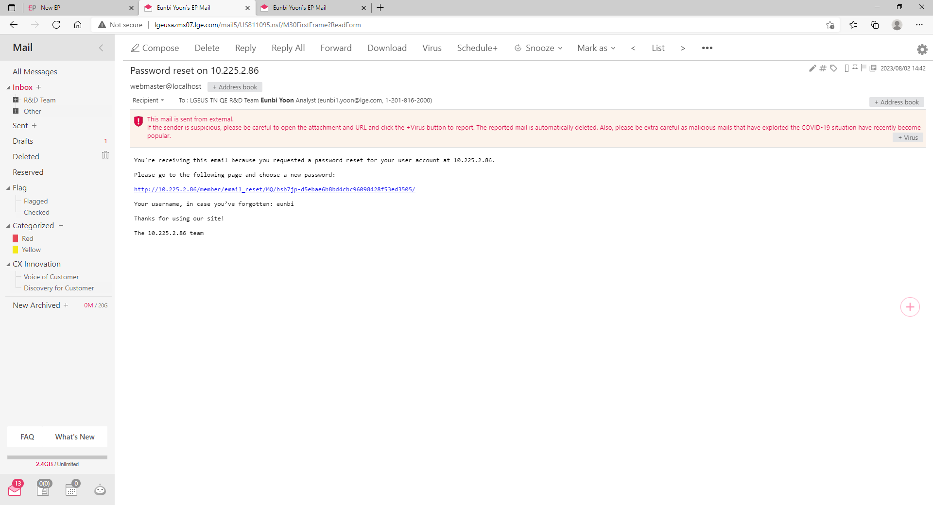
1. Sign Up, Log In Page - Forget Username/Password
If you forget password or username, please click “Forget Username/Password”. You will receive email showing username and password reset link.
Click the link to reset your password and this link is only valid for 10 minutes. If you passed 10 minutes, then click “Forget Username/Password” once again.
1
2
Click to send password reset link and username information to your email and there is no limit of this request.
It should be matched with email that you fill when sign up.
After this, click reset my password
3
4
Subject Line: Password reset on 10.225.2.86
Password can be reset if you click this link
You can check your username
Check email sending confirmation message

Slide 6
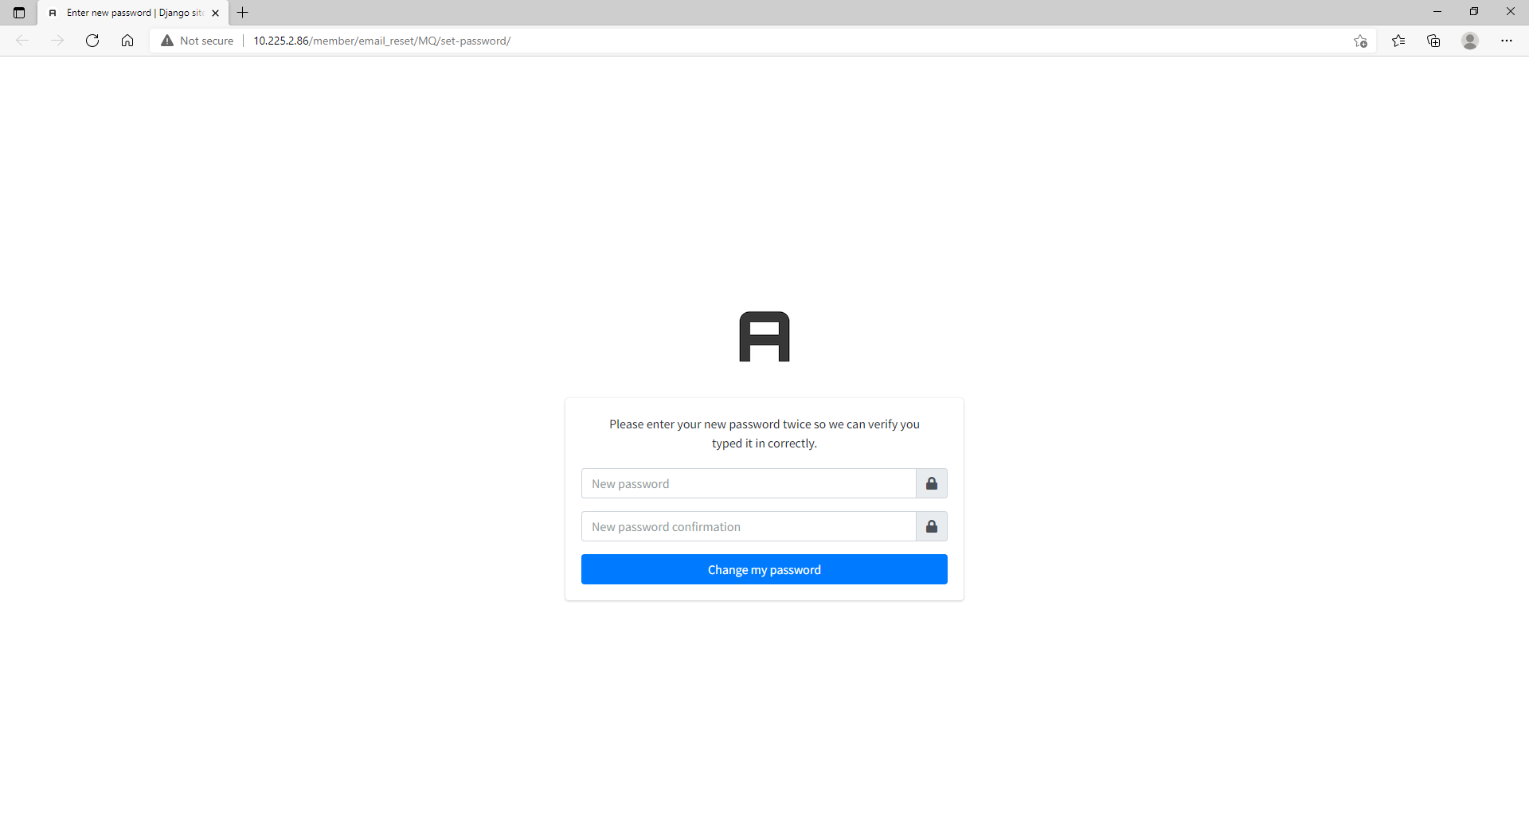
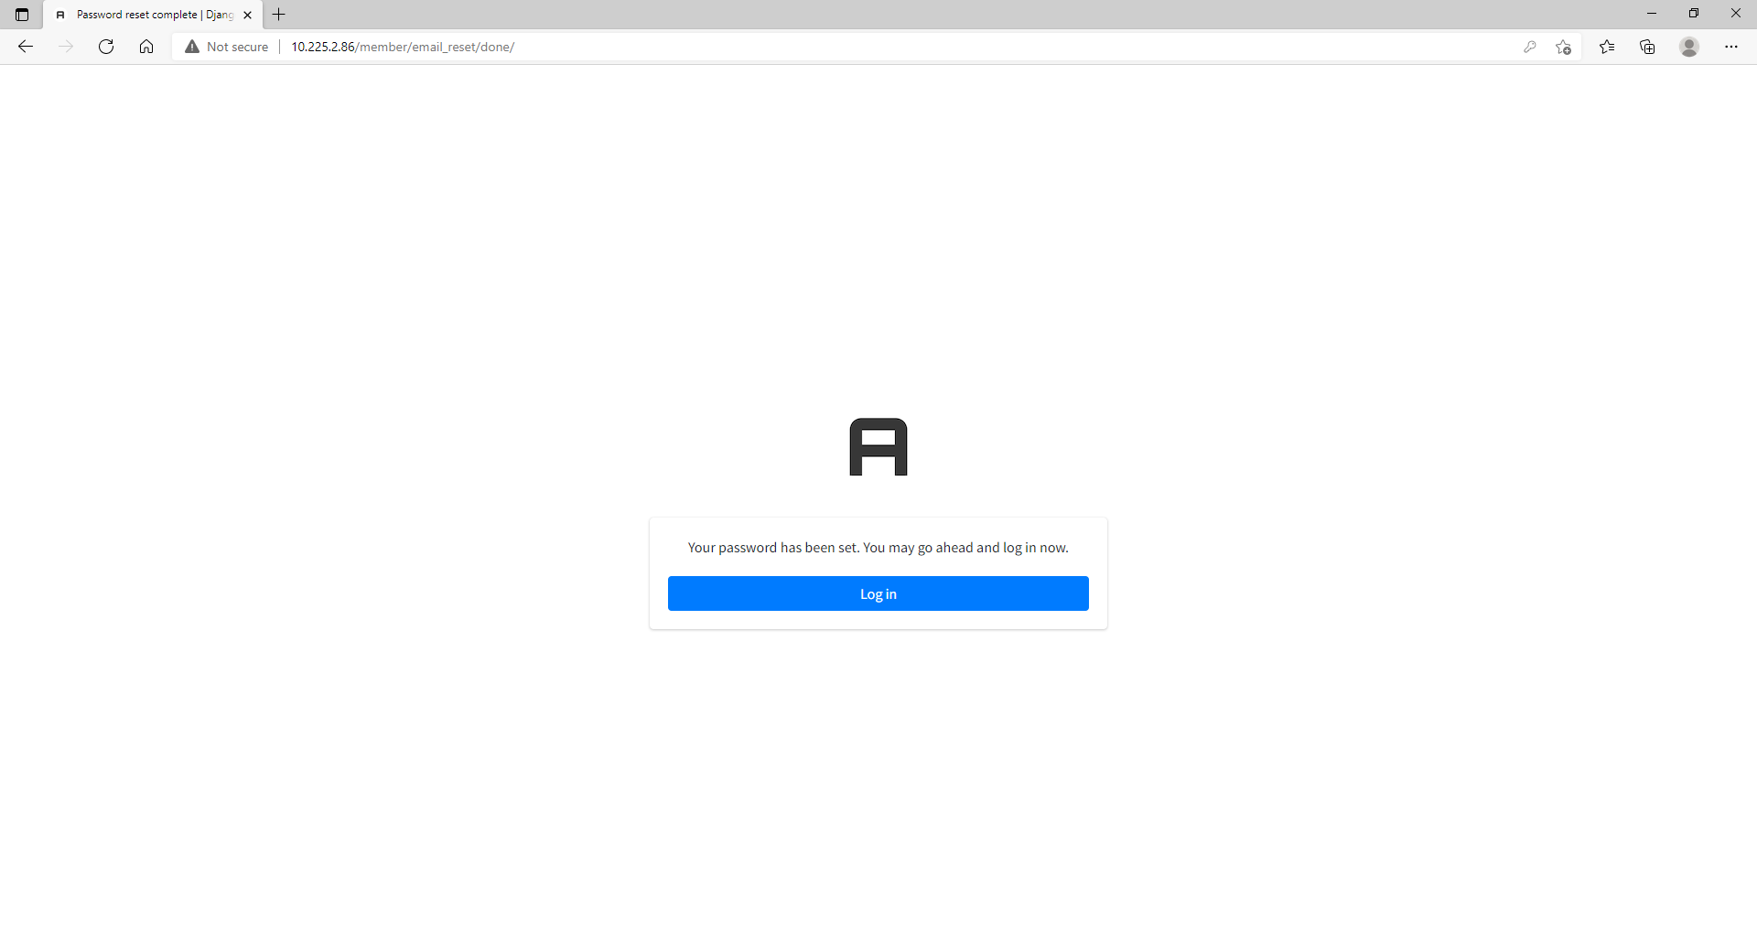
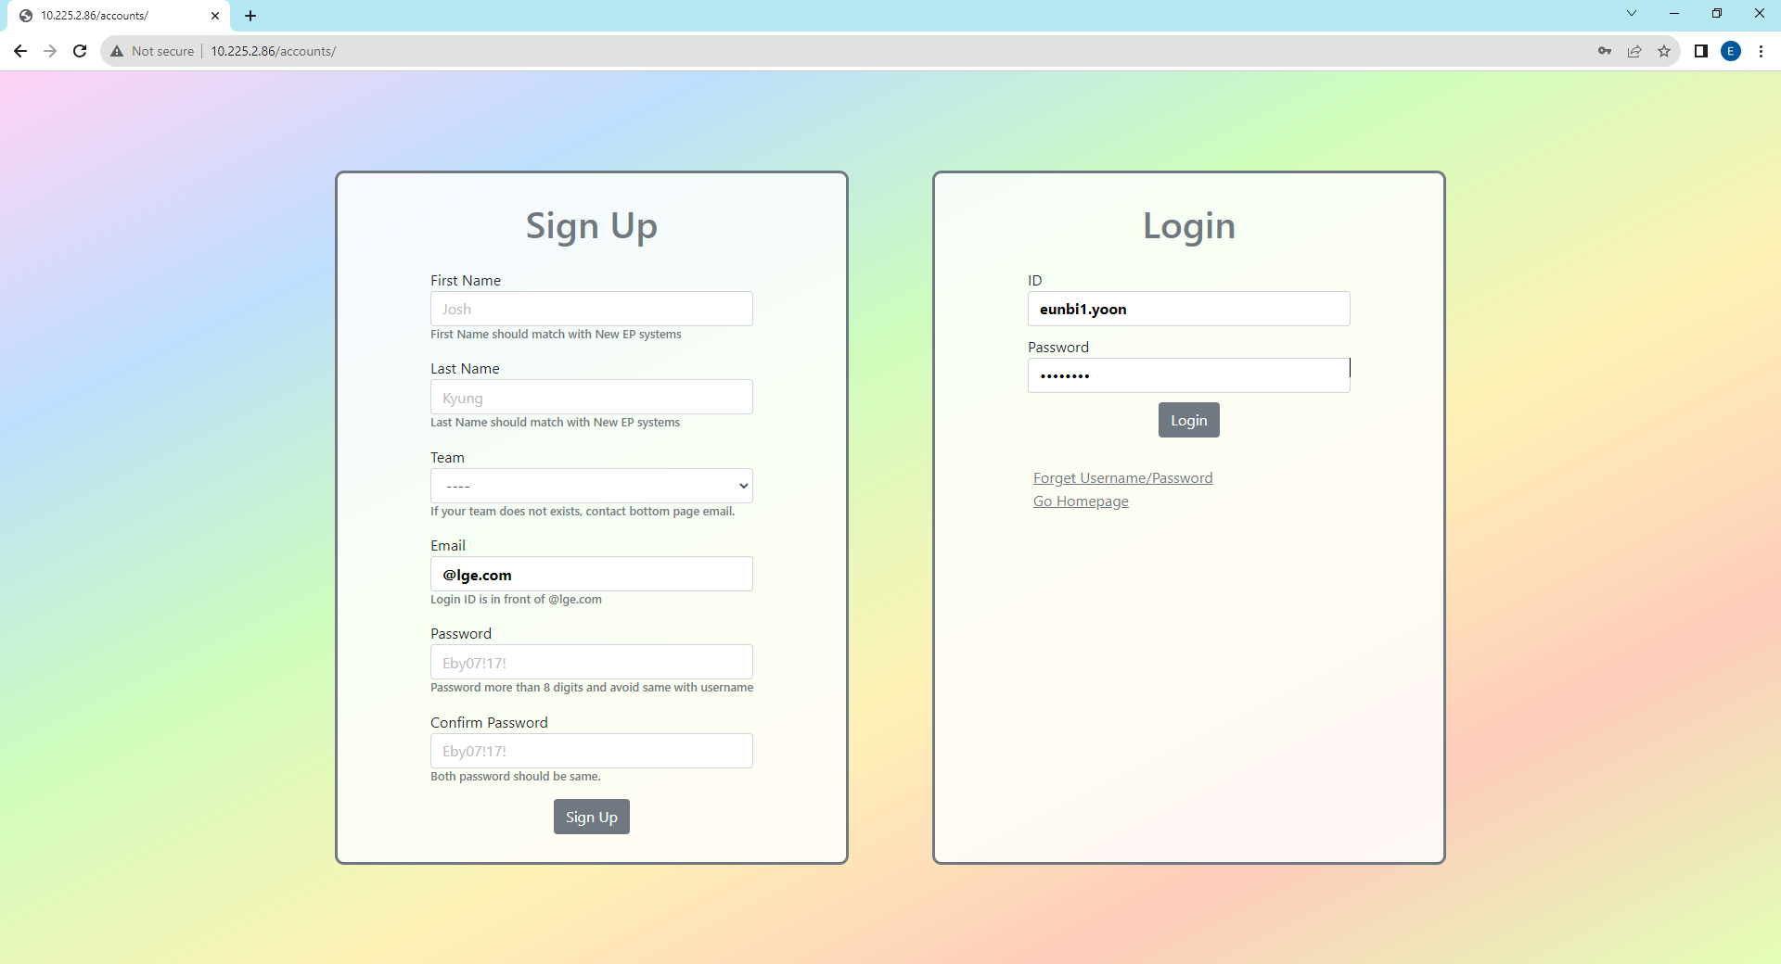

1. Sign Up, Log In Page - Forget Username/Password
If you forget password or username, please click “Forget Username/Password”. You will receive email showing username and password reset link.
When you enter email address to reset your password, it should be LG Email(@lge.com) and match with email address that you sign up.
5
6
Enter New Password
Click the link to go to login page
7
8
Successfully login to your account
Login with new password

Slide 7
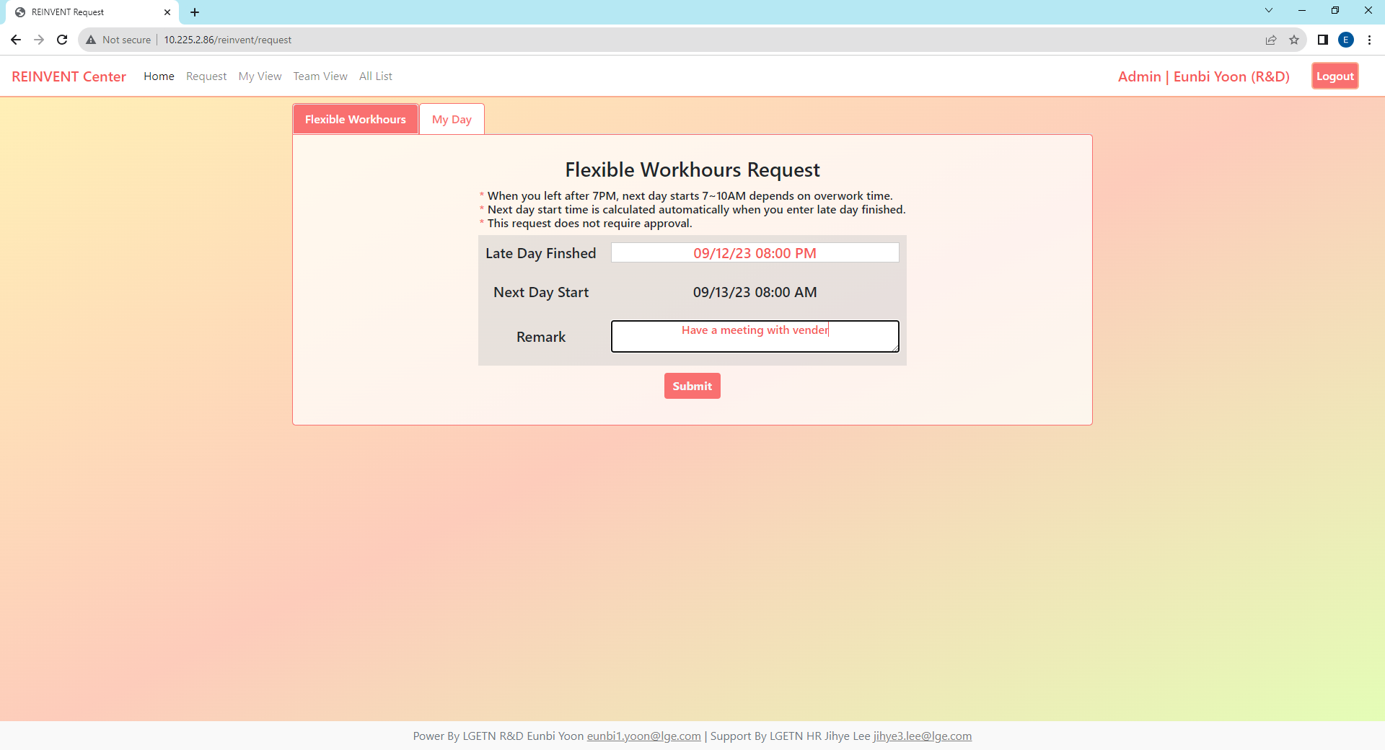
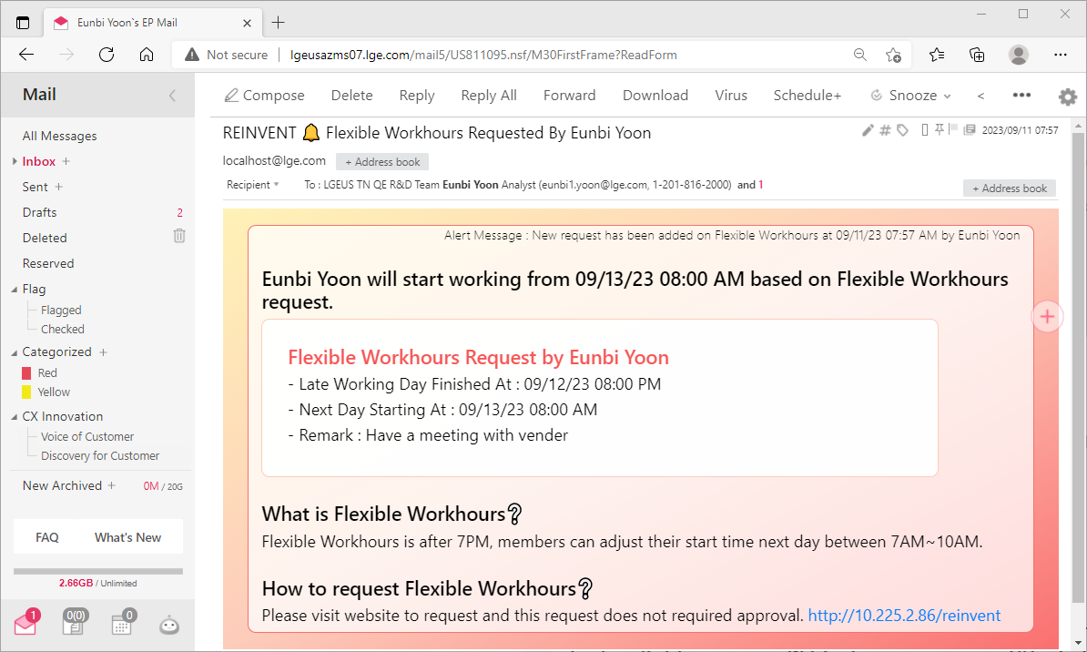
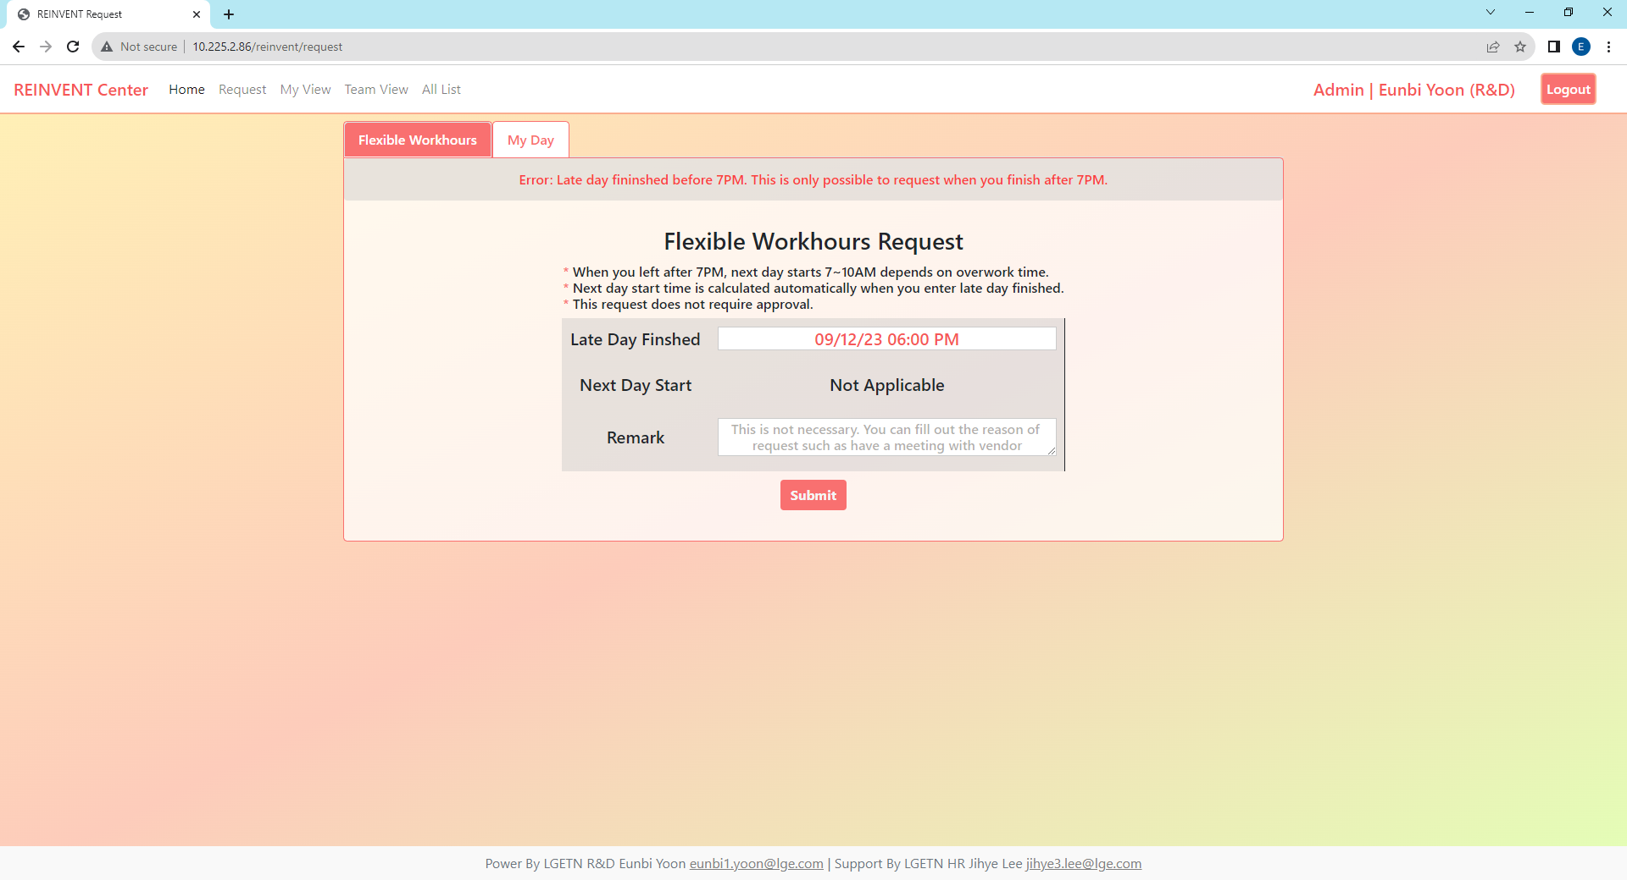
2. Request Page - Flexible Workhours
This program is not required your manager’s approval and there is no limit to the number of requests you can make as long as you finish after 7PM.
After request, you and your manager will receive the message and if your manager’s email is wrong, please contact to HR admin (jihye3.lee@lge.com)
1
2
Quick Menu
Click Request
Remark is not necessary
When you select late day finished,
it calculates automatically next day start.
3
Alert Message By Email to requester and requester’s manager.
Error
This program is applied when you left after 7PM, next day starts 7~10AM depends on work time.
Therefore if you request before 7PM, it will display next day start as “Not Applicable” and error message on the top.

Slide 8
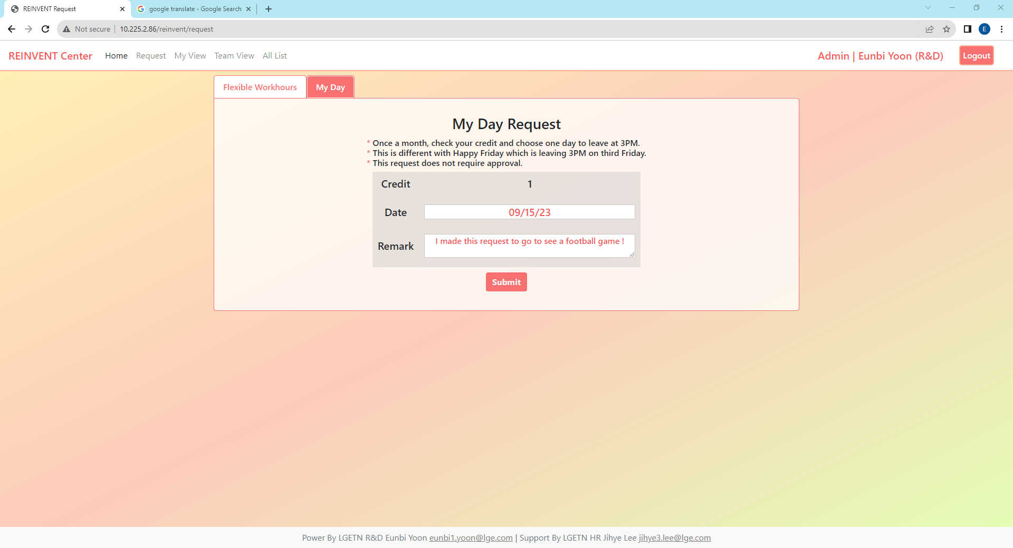
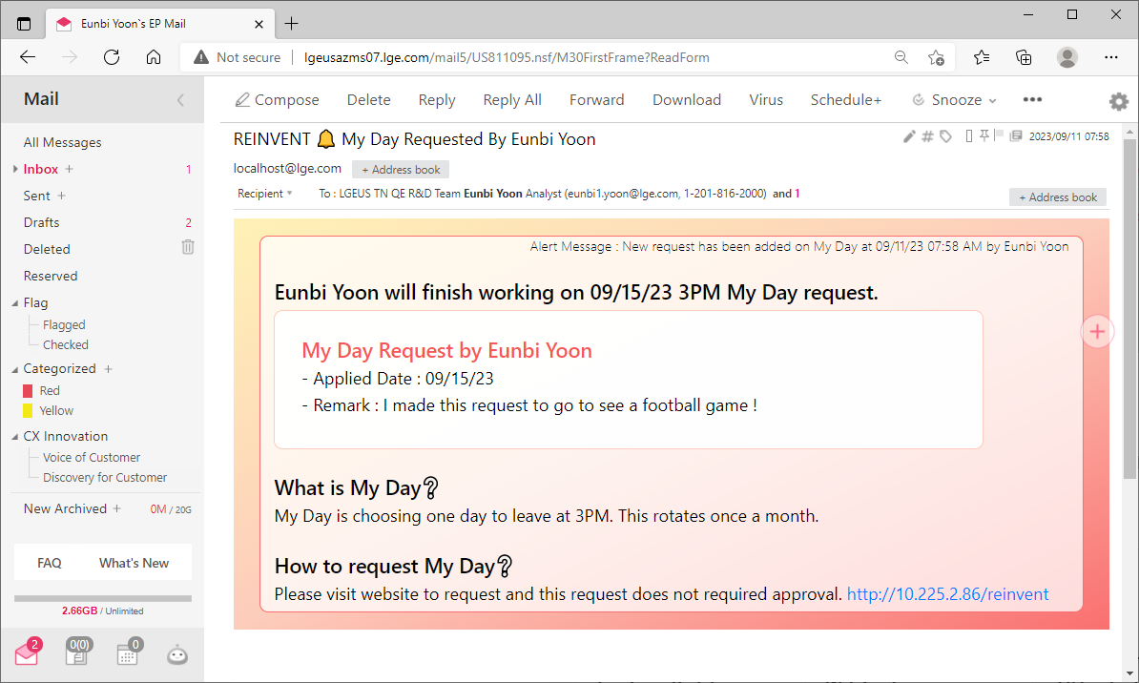
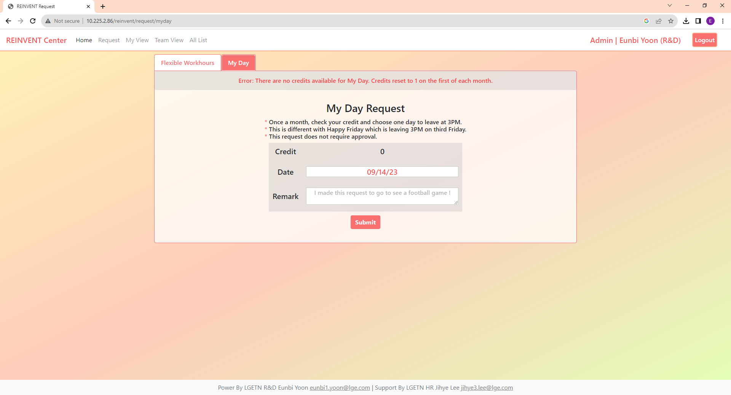
2. Request Page - My Day
This program is not required your manager’s approval and you can only use once a month. It is different with Happy Friday(3rd Week Friday Leaves at 3PM).
After request, you and your manager will receive the message and if your manager’s email is wrong, please contact to HR admin (jihye3.lee@lge.com)
1
2
Quick Menu
Click
Click
Every Month, you will gain 1 credit to request My Day
3
Alert Message By Email to requester and requester’s manager.
Error
This program is applied once a month and choose your day to leave at 3PM. Therefore if you already requested my day this month, your credit changed to 0 in database and it display credit as “0” and error message.

Slide 9
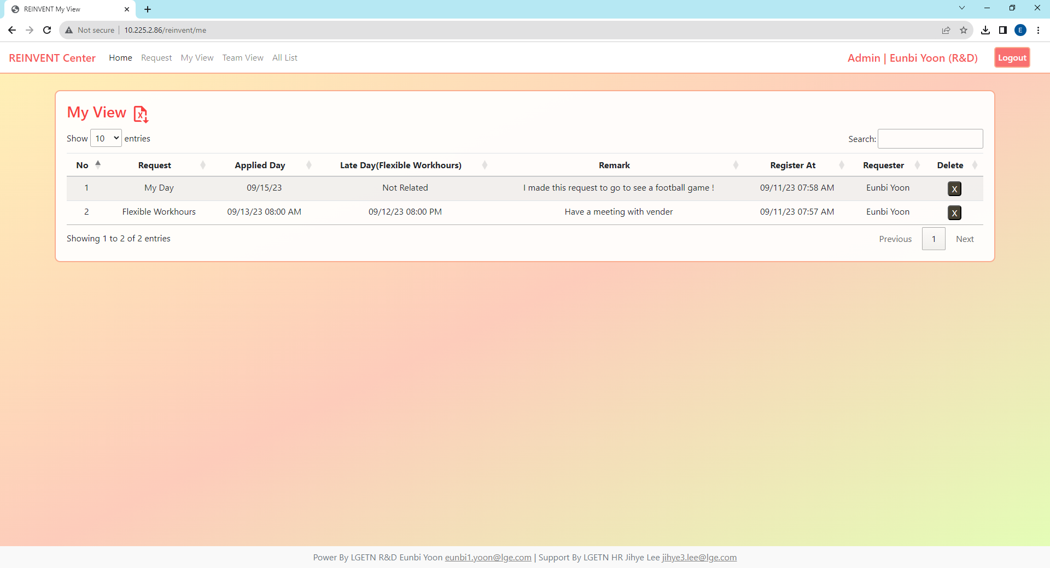
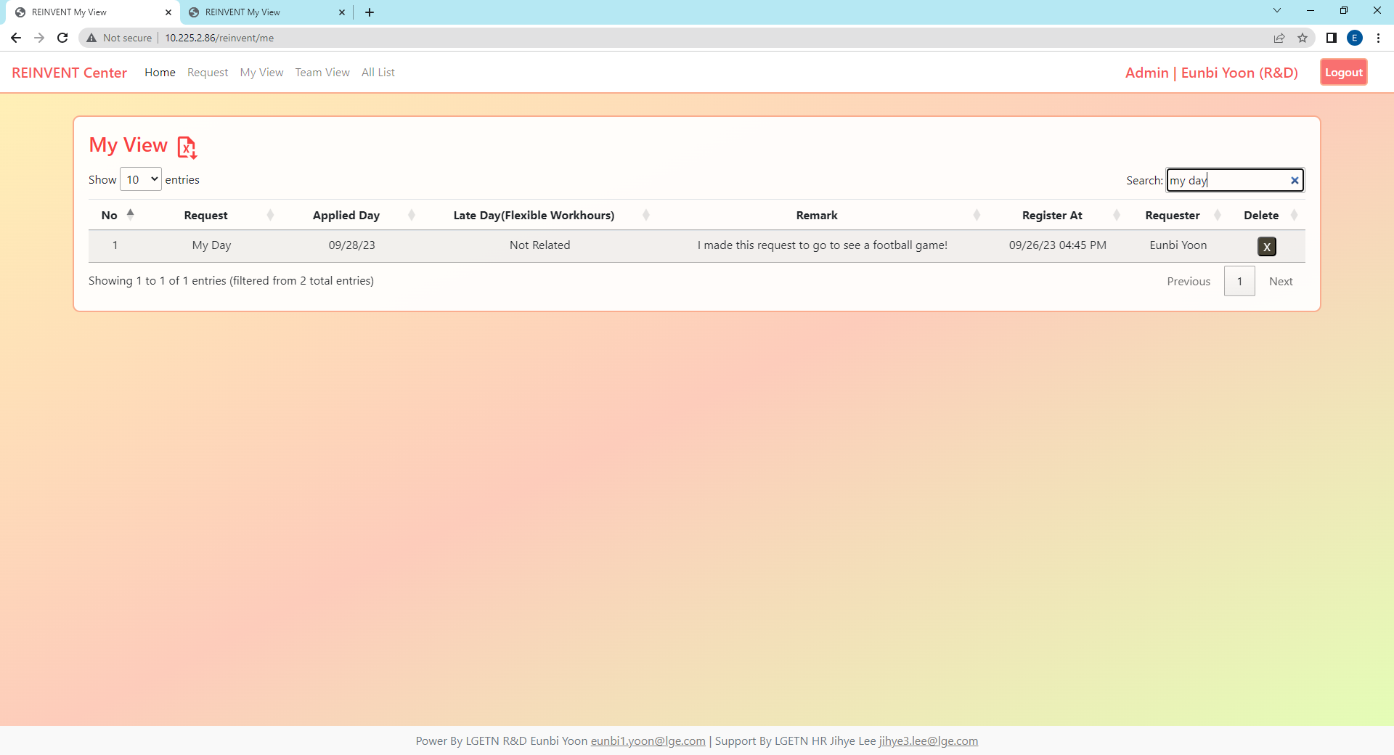
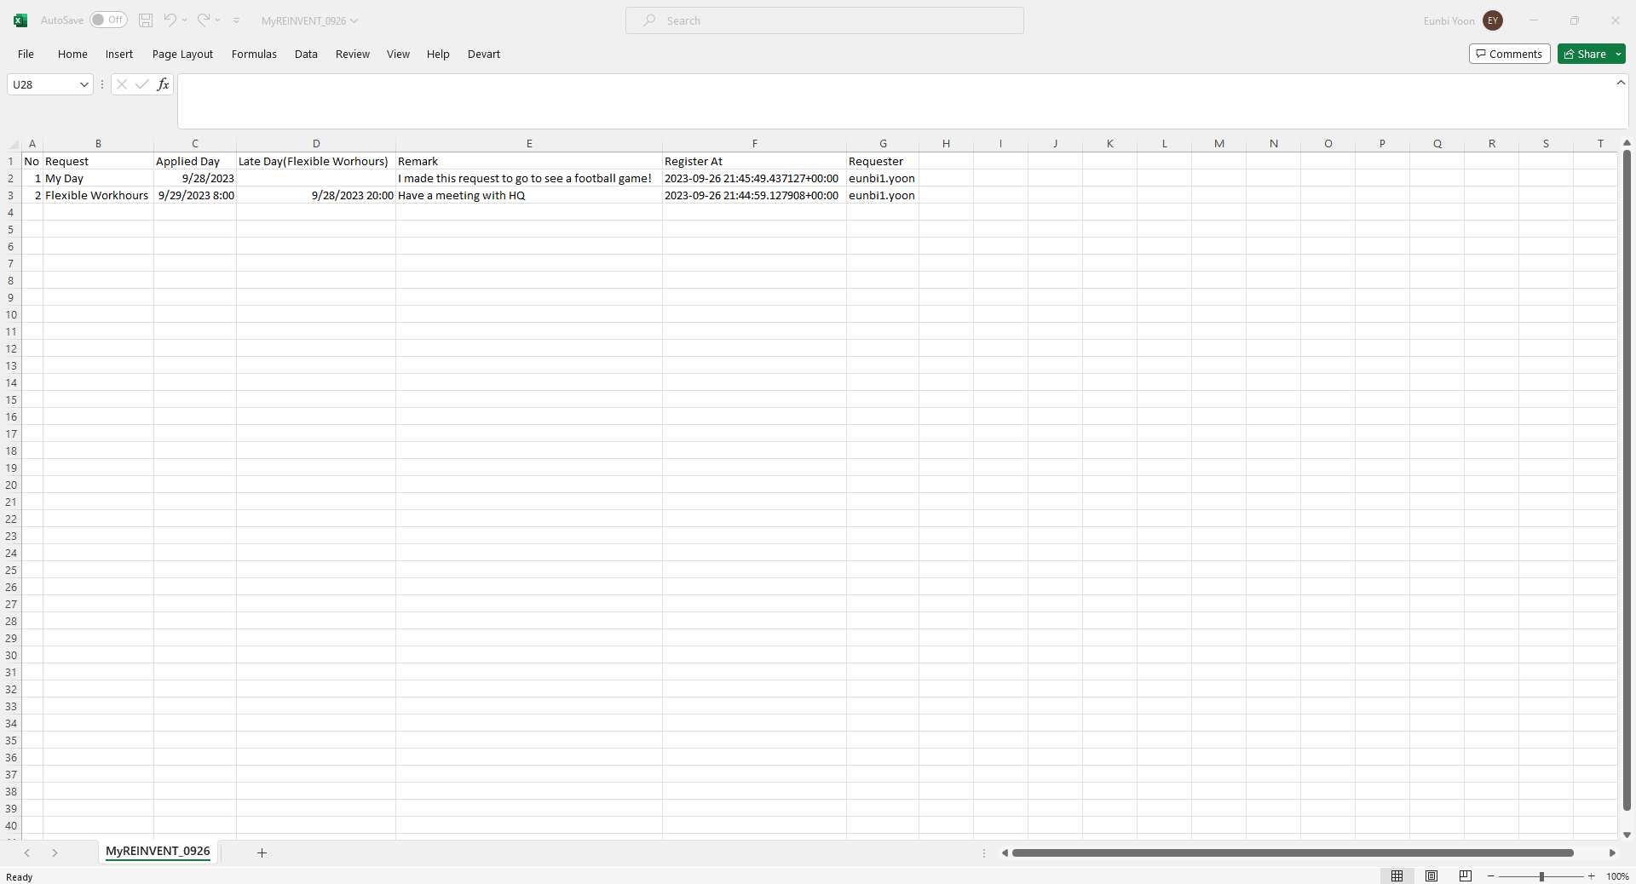
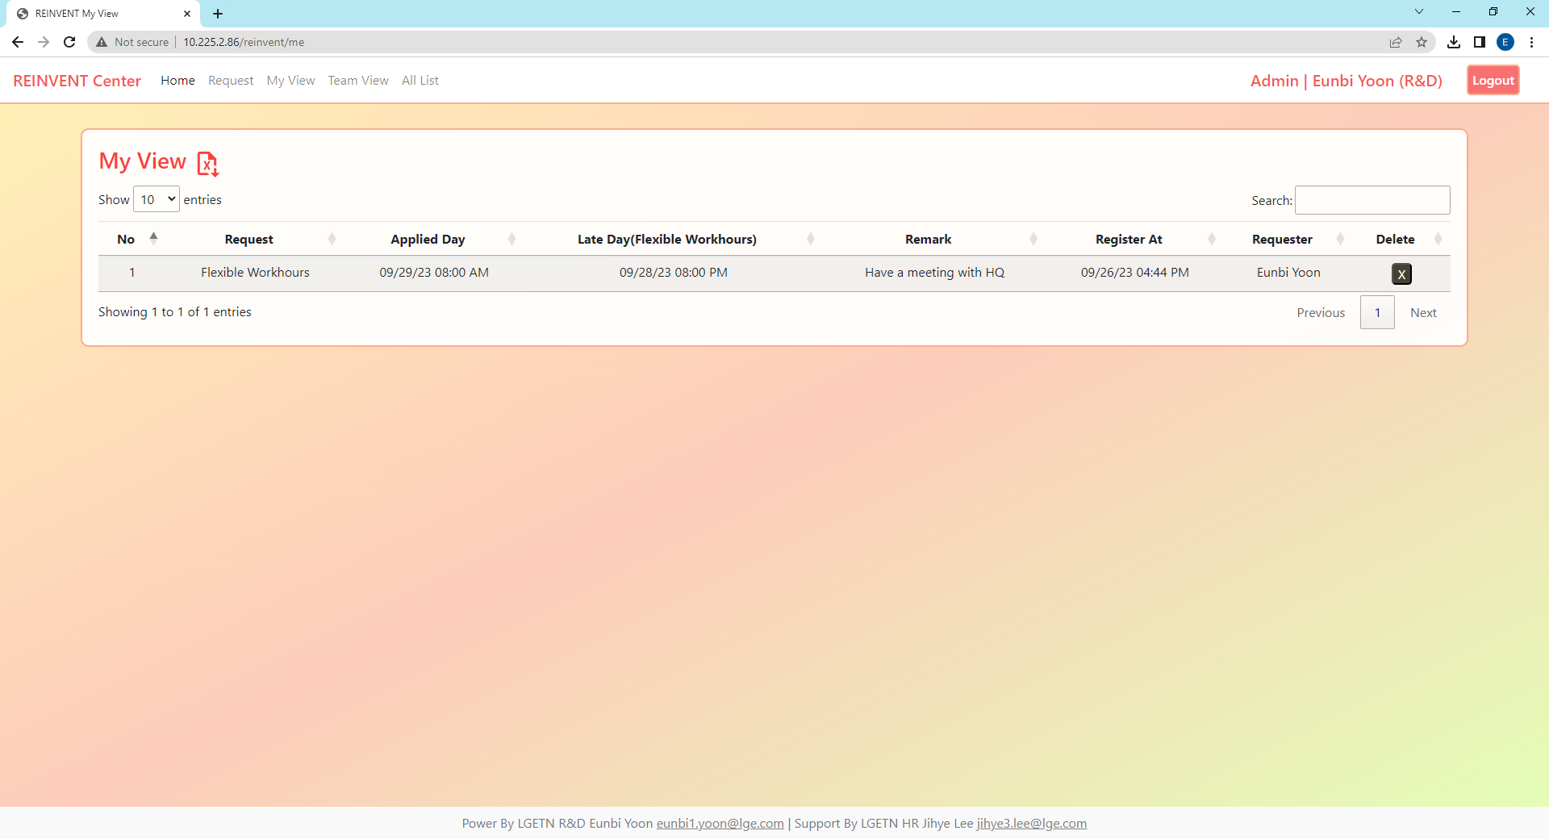
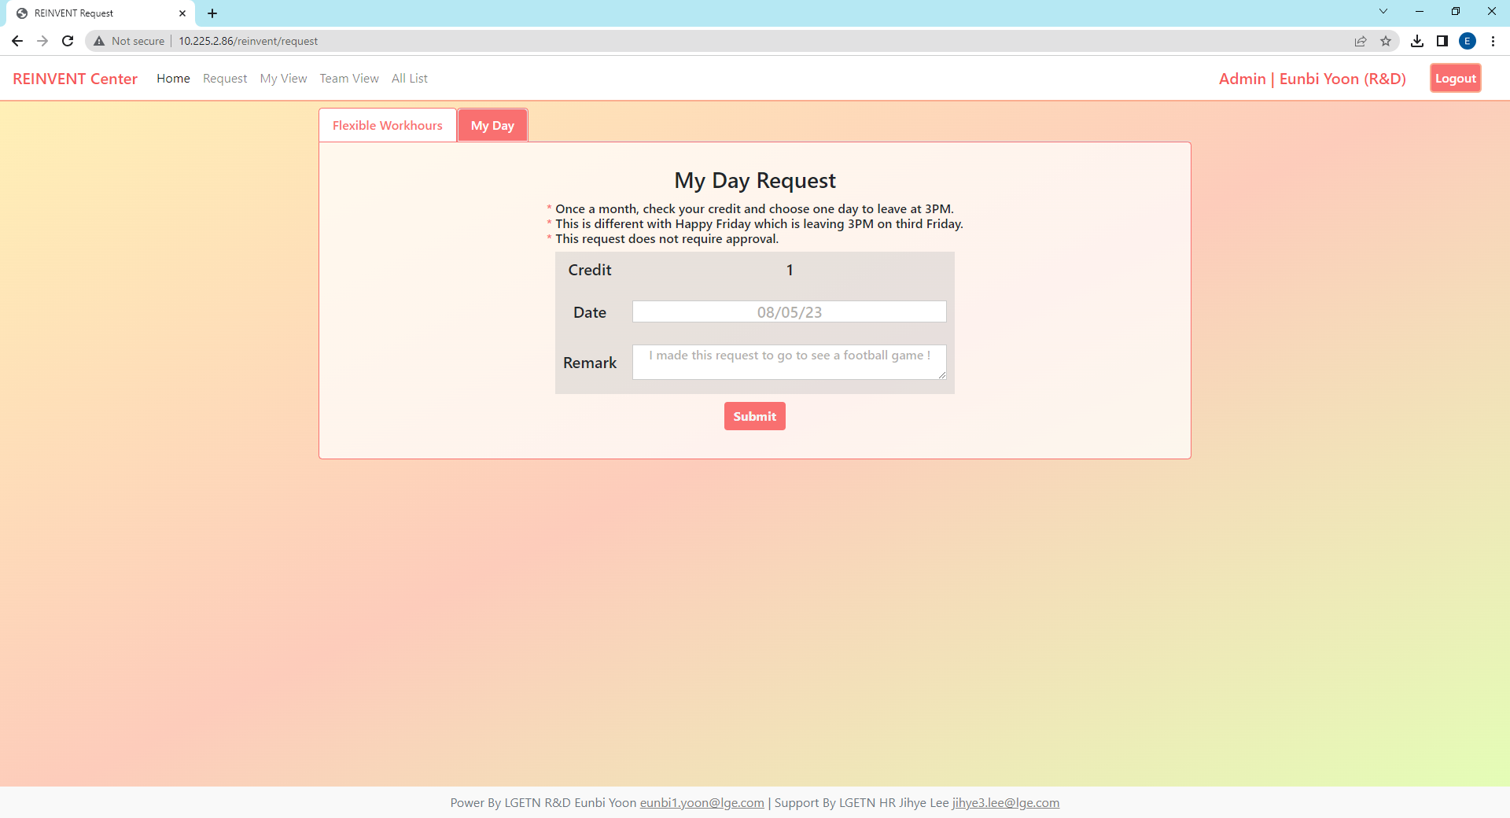
3. View Page - My View
If you want to change your request, please delete your request in “my view” and request again in “request”. Delete button can use only in my view page.
Check your request and track on the
Click
Search Function
Quick Menu
Decide how many rows to place
Total Request Counts
Search Function is working for all columns.
Search with program, register date, or etc.
Excel Download Function
Delete Function
When you delete my day program, your credit restore to 1 like above.

Slide 10
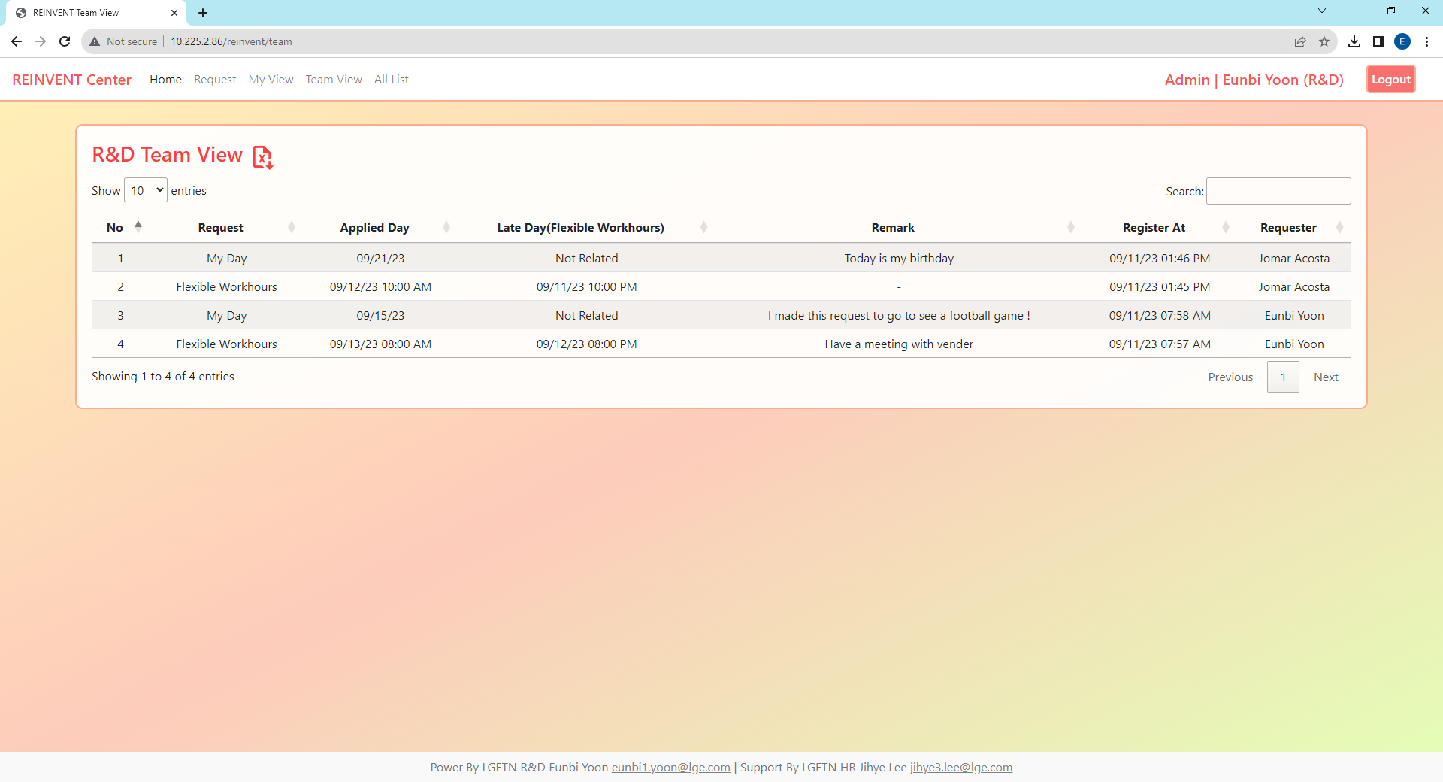
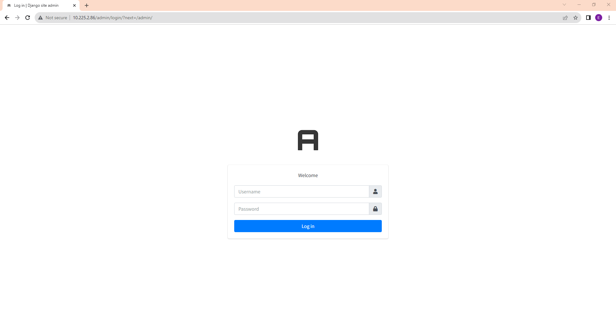
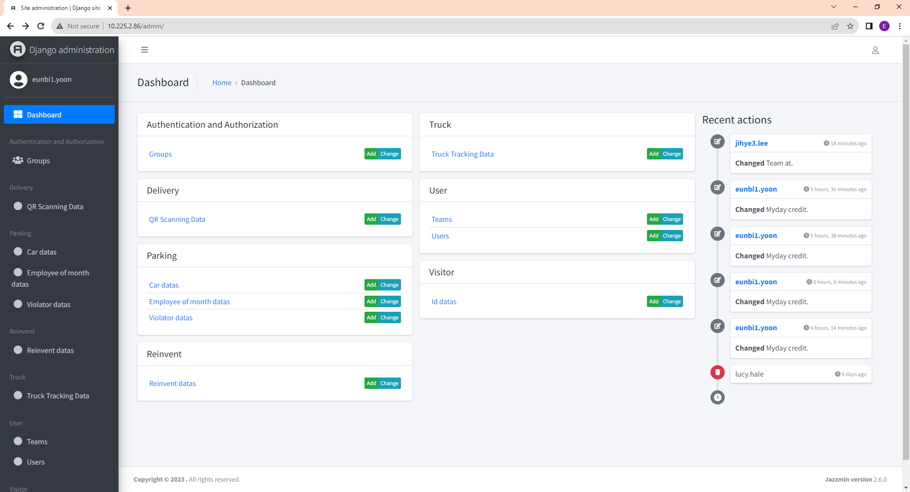
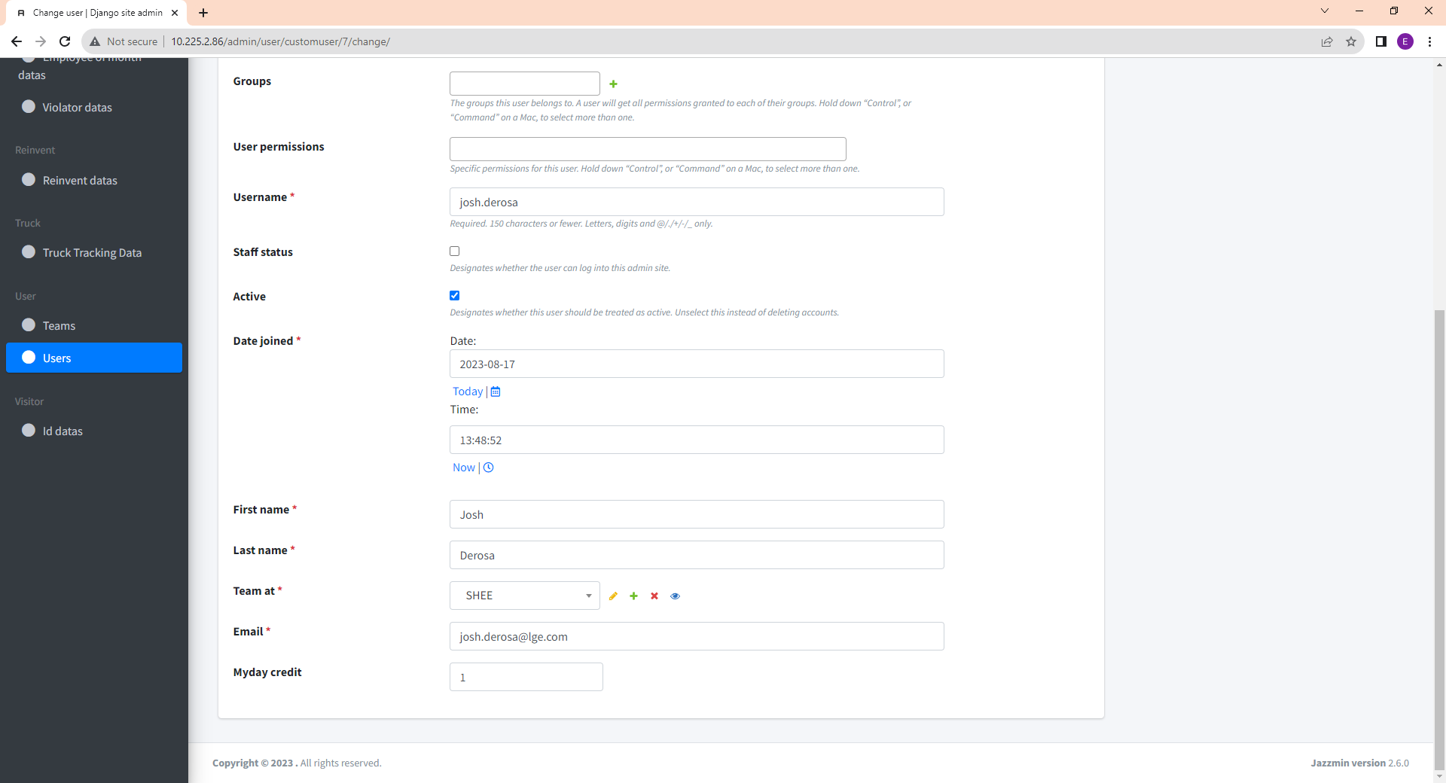
3. View Page - Team View
In this page, you can see all of your team requests status and download excel files. If team info is changed or wrong, contact to HR admin (jihye3.lee@lge.com).
Admin should follow below guide to change user’s team name or my day credit and monitor the history of user’s request.
Team View
Admin - Guide1
http://10.225.2.86/admin
Access Admin Dashboard and
login to your account
Admin - Guide 2
Admin - Guide 3
Review Recent History
of Database
Click User
Check Team at,
My Day Credit
If team is not existed, click this “+” button to add team database

Slide 11
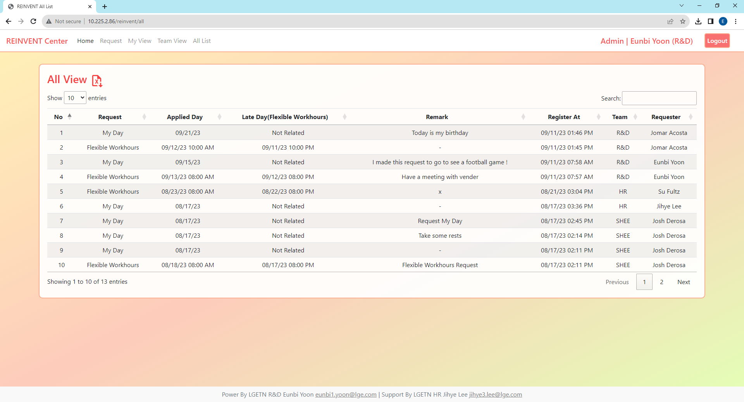

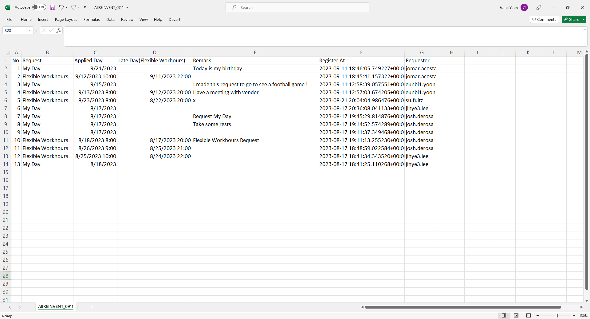
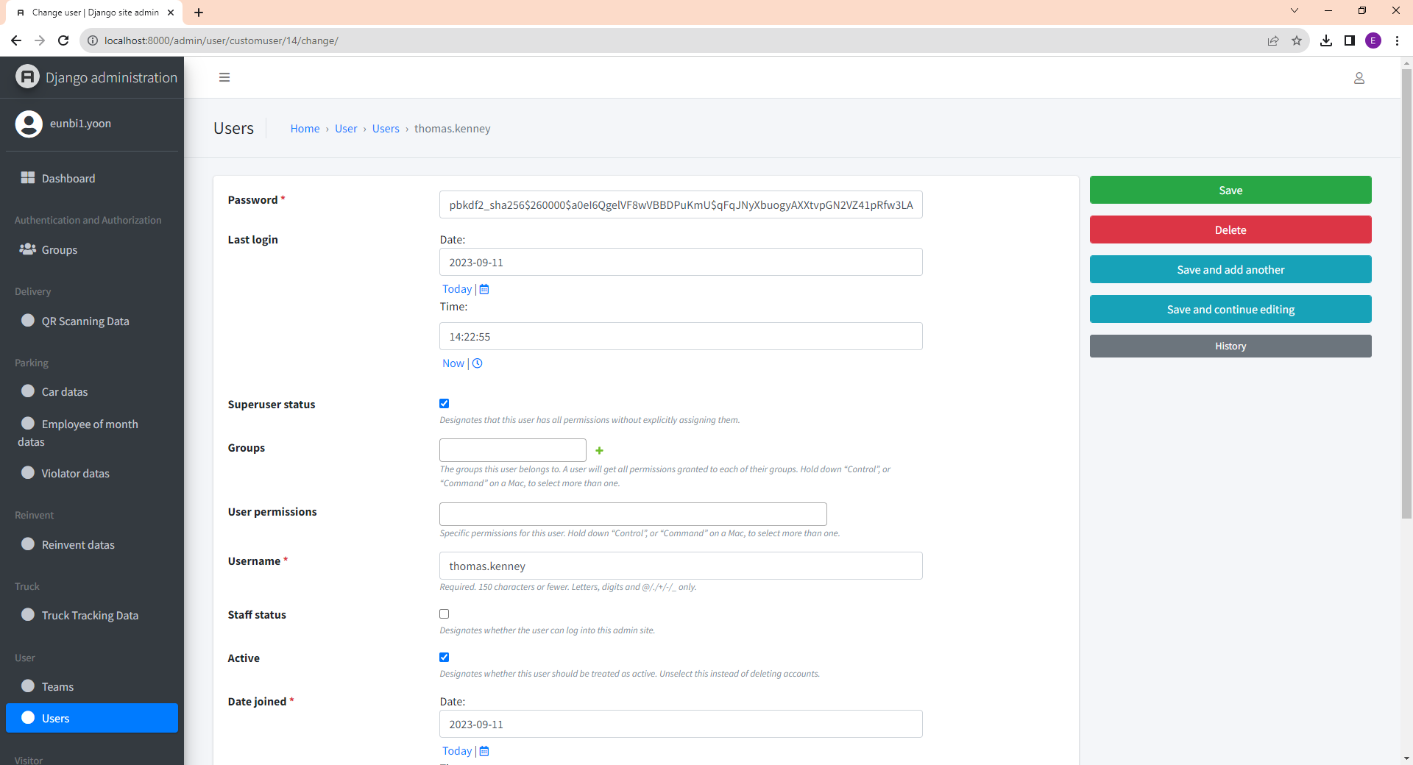
3. View Page - All View
Only admin accounts are able to see all request history and if you want to change your account as “Admin” please contact to HR admin (jihye3.lee@lge.com).
If you want to make this request as excel file, then please click the file icon and check your download folder.
If you have admin account,
You can see “All List” in Quick Menu
Admin View
User cannot access to All View
User View
All Team Requests Review
Download File
http://10.225.2.86/admin
Access Admin Dashboard and
click user to able to see “All View”
Account Change
If superuser status checked,
it will change you as “admin” accounts.
Column: Program, Applied Day, Late Day, Remark, Register At, Requester, Team Info
I don’t recommend to click this, since user can access admin dashboard
and view, delete, add to all database.
Even you click the icon, there is nothing happen,
please check Download Folder.

